Slide 1
AZ Web Dashboard :Unified Solution for Comprehensive Data Management
14th May 2025

Slide 2
Login page
We have separate login pages—one for Managers and another for PMs and WLs.
Managers will have access to view and download data only. PMs and WLs will be able to input data relevant to their respective regions, which will be stored in the backend and displayed accordingly on the front end.

Slide 3
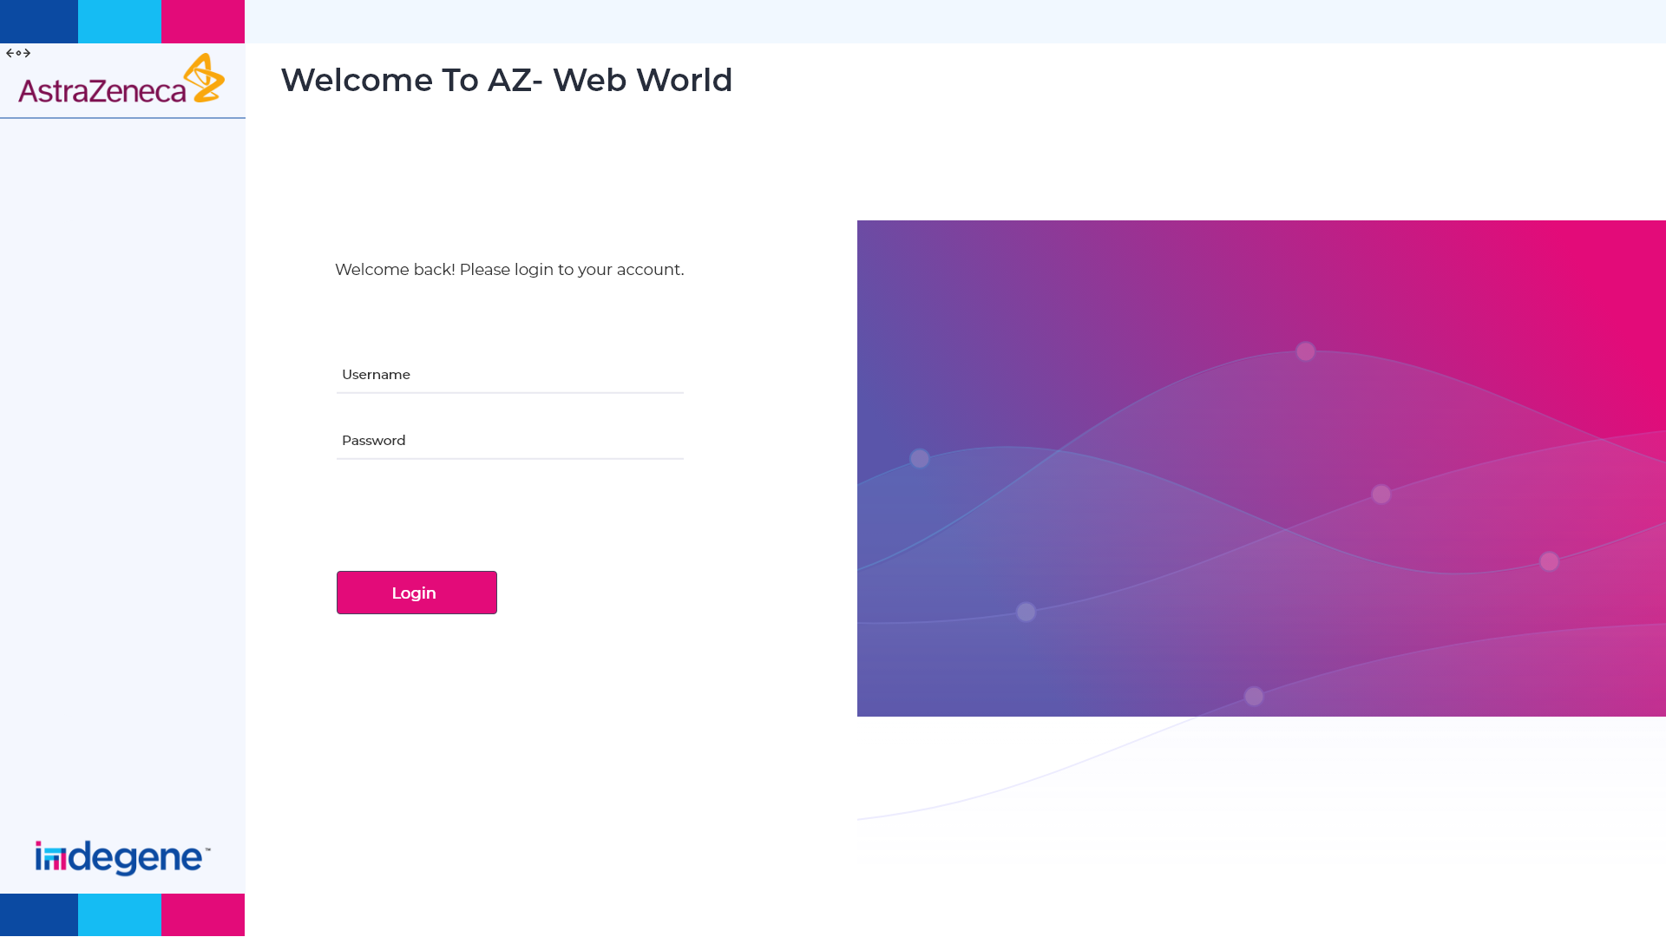

Slide 4
Overview
The main dashboard page highlights key data and includes clickable elements that redirect to the corresponding detailed pages.

Slide 5
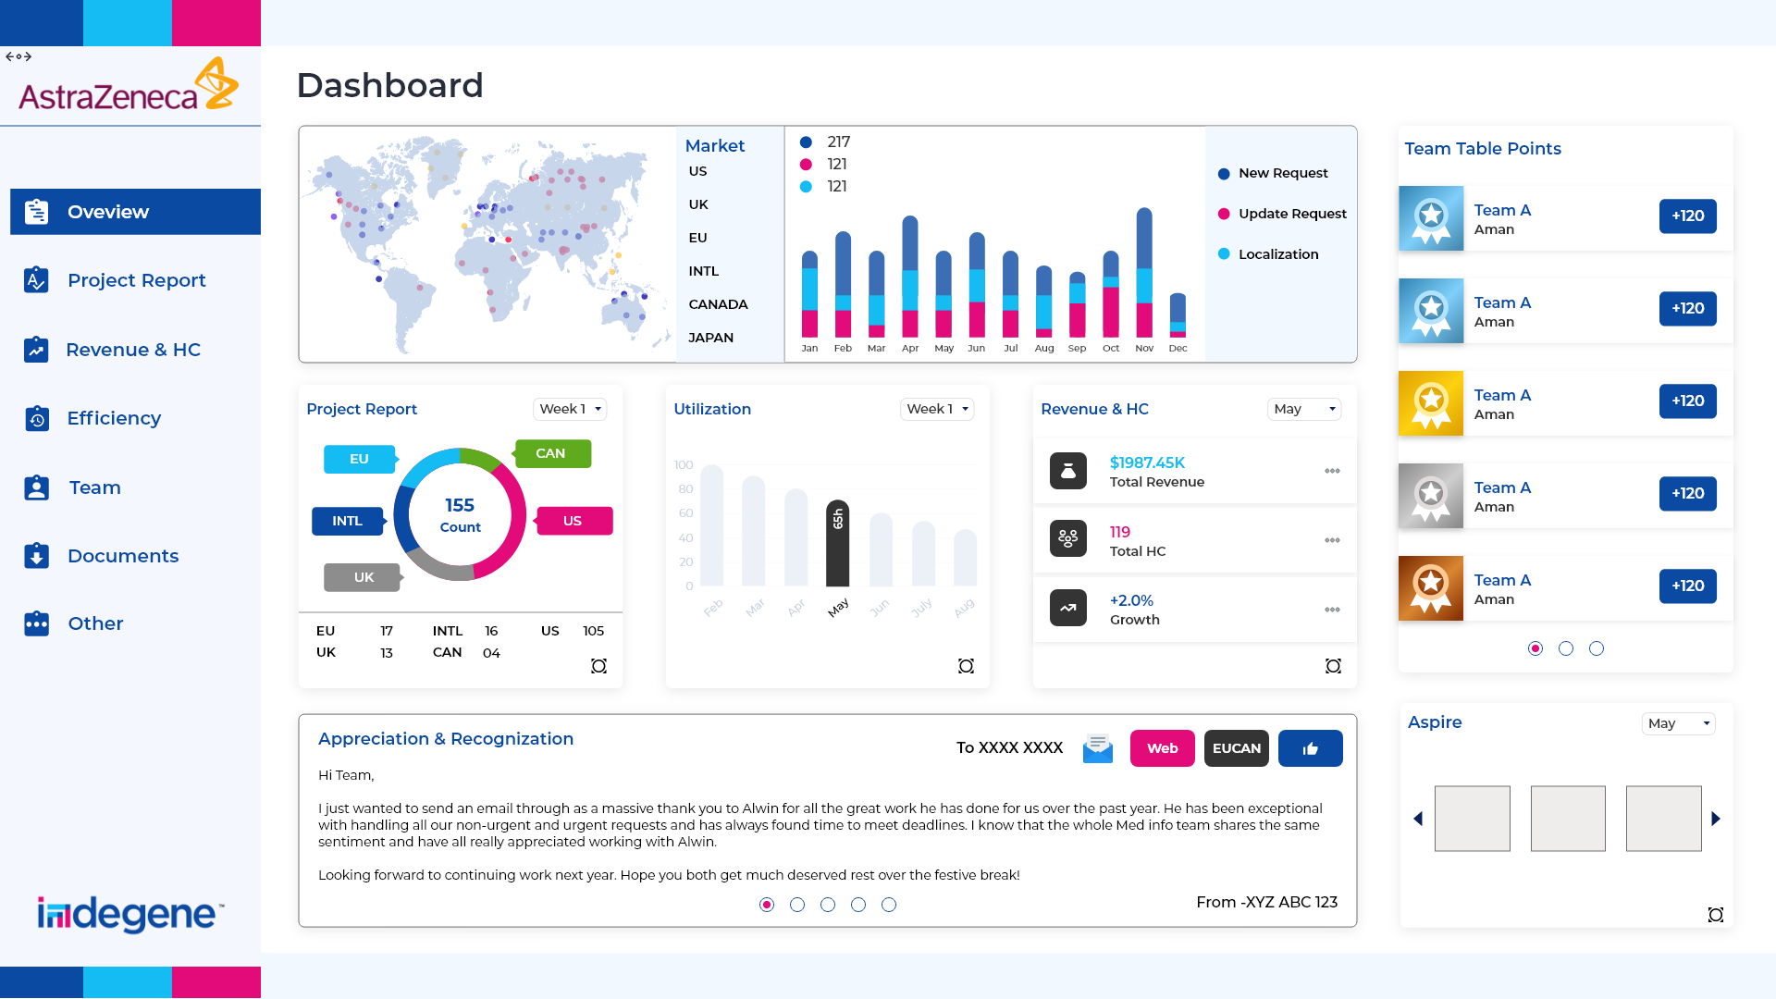

Slide 6
Project Tracker
PMs will update project information specific to their respective markets, allowing us to consolidate all market data in one centralized location. This data can then be filtered by region, enabling us to track project status at every level.

Slide 7
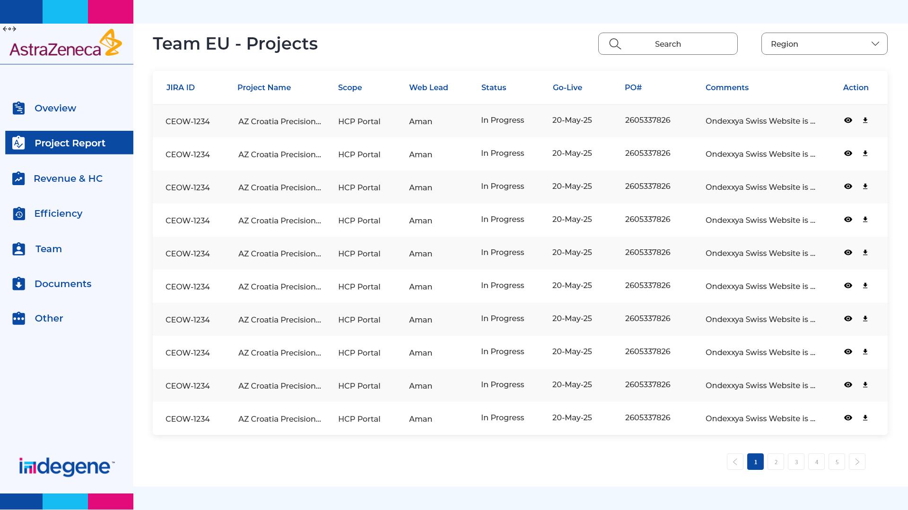

Slide 8
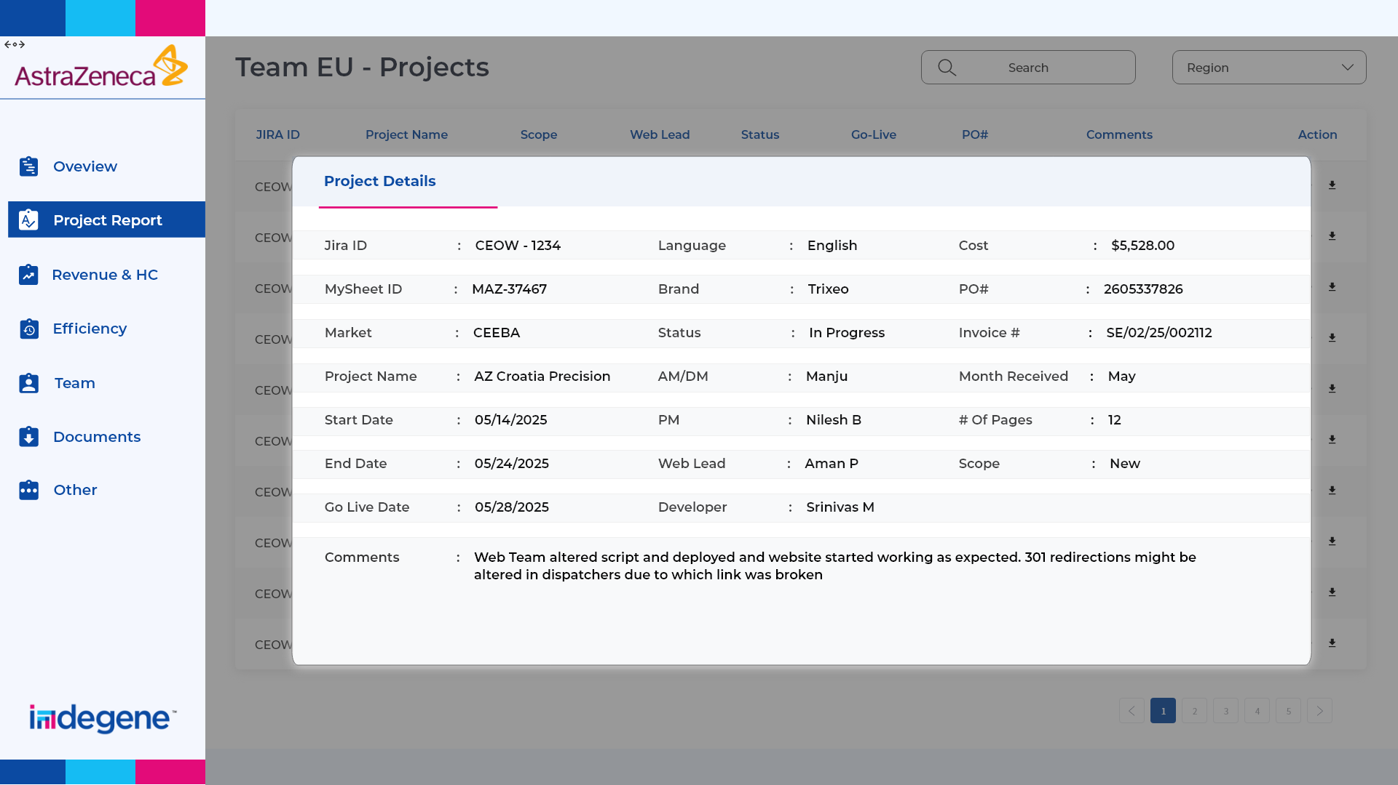

Slide 9
Revenue & HC
This page will provide a detailed market-wise breakdown of revenue, allowing us to track quarterly progress in both revenue and headcount. This insight will support more effective planning and execution for the upcoming quarter.

Slide 10
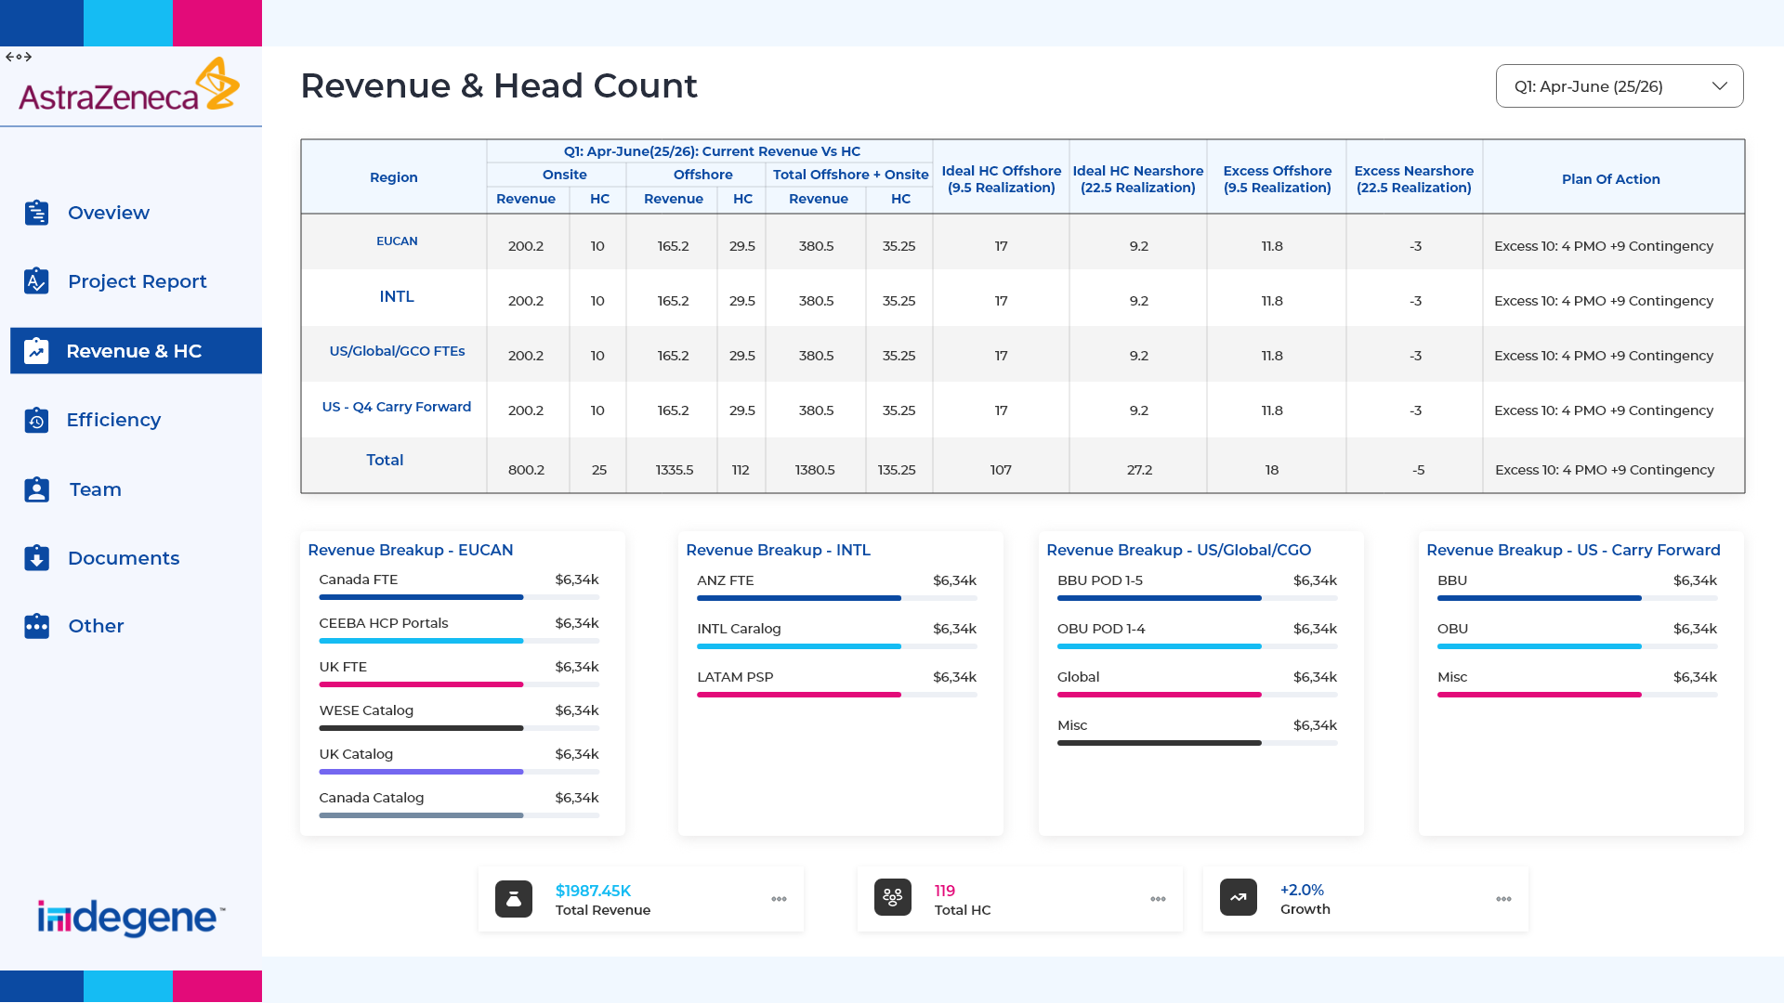

Slide 11
Efficiency – Resource Productivity, Utilization, and Availability WLs have full visibility into resource leave schedules, availability, and project forecasts. This enables effective planning and utilization of resources, including reallocating them to other regions as needed for support.

Slide 12
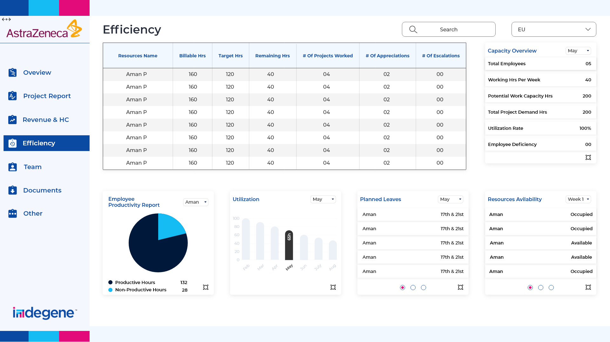

Slide 13
Team
We often need to request information like Email ID, DOJ, and PRID ID from team members to grant access or review their skill sets. By centralizing this information in one place, we can manage it more efficiently. It will also help in tracking headcount across individual regions and the entire AZ Web team.

Slide 14
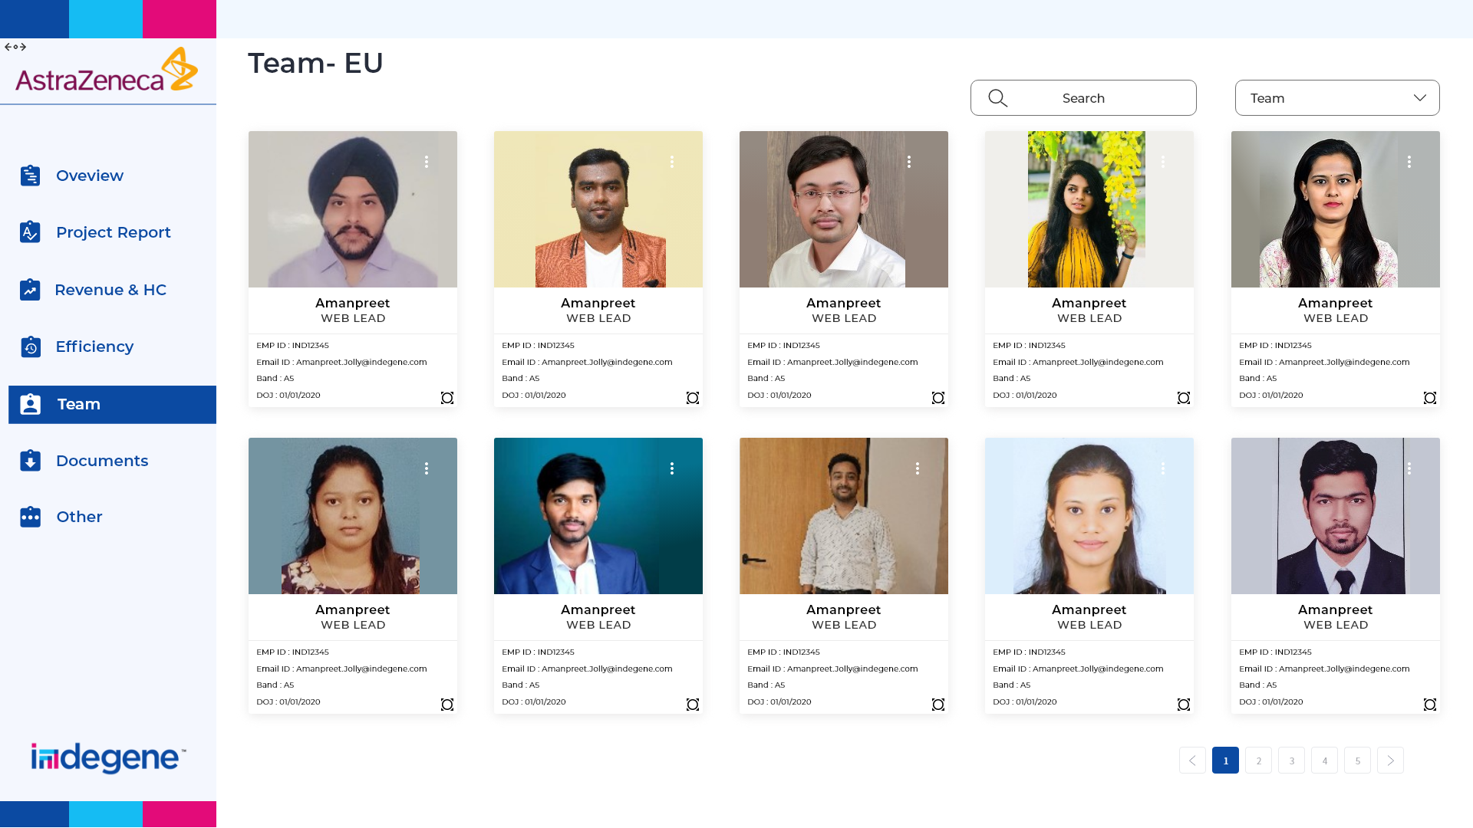

Slide 15
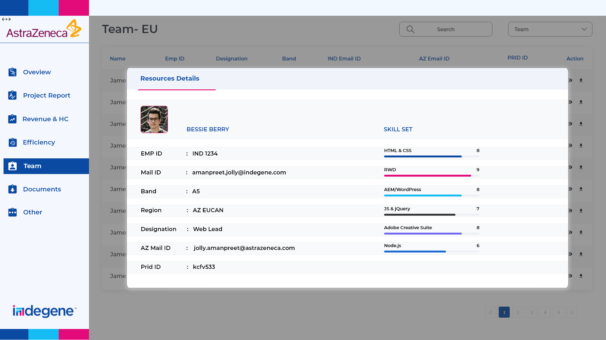

Slide 16
Documents – Training Materials, Video Tutorials, Process Flows, Organizational Documents This page will serve as a centralized repository containing all relevant documents, making it easy for both new and existing team members to access

Slide 17
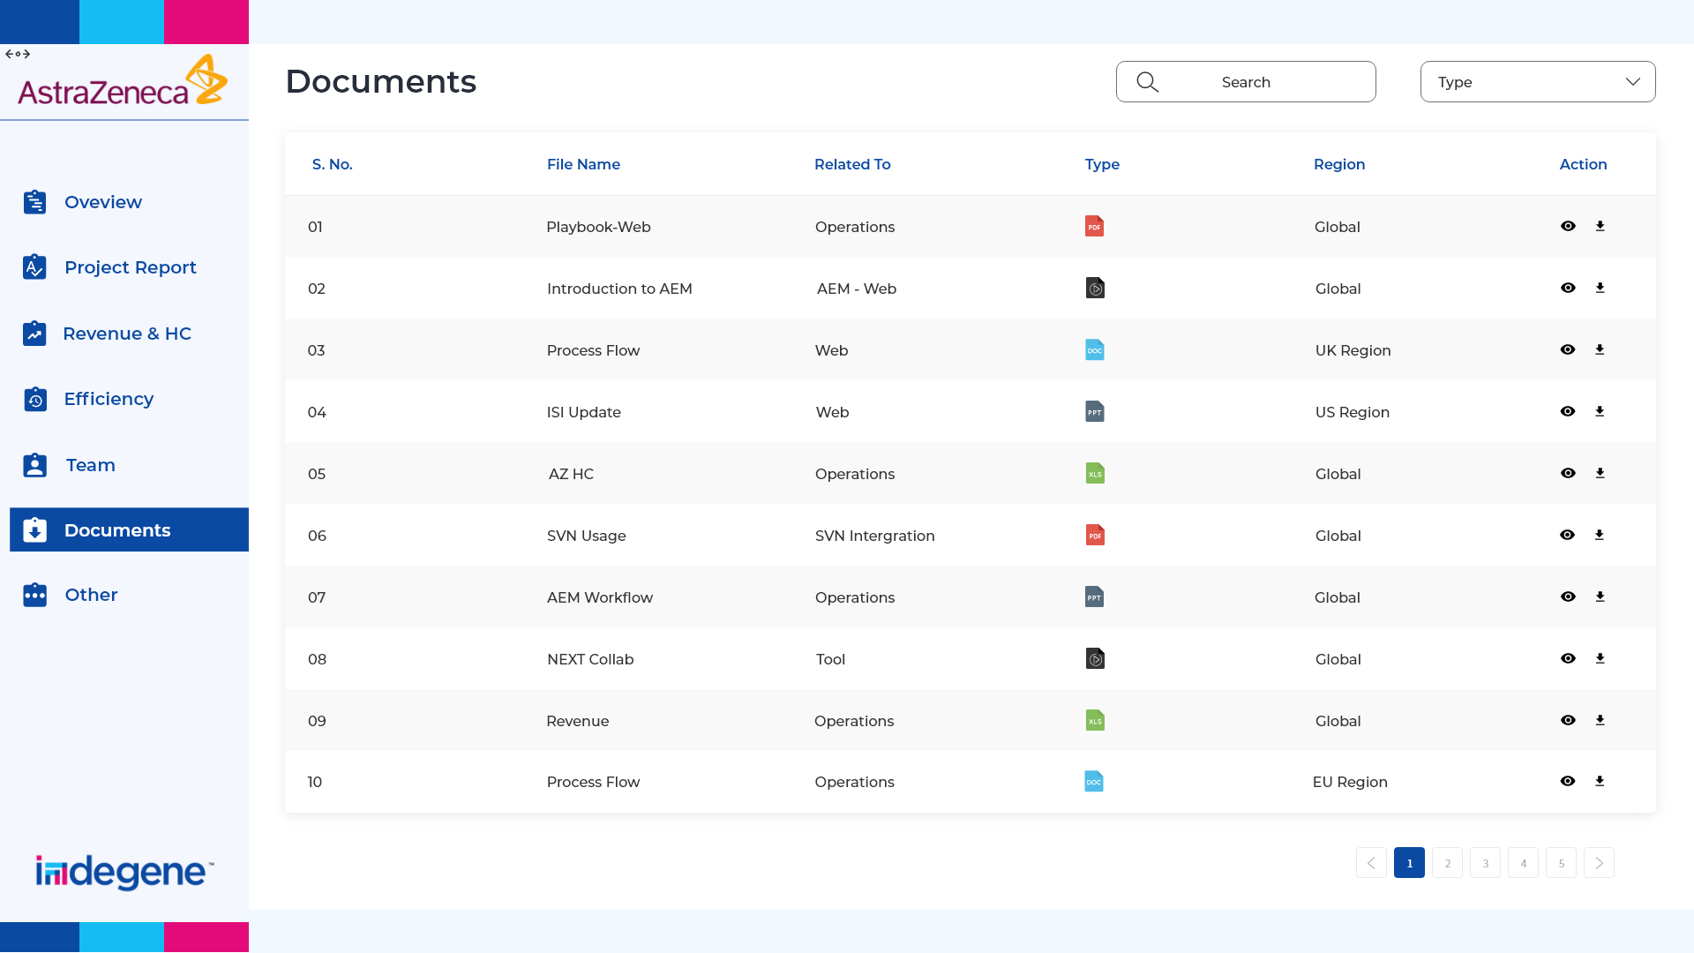

Slide 18
Others – Testimonials, Aspire, Weekly & Monthly Project Reports, Issue & Risk Tracker, Case Studies & RCAs This page includes various sections where the team regularly manages and updates data on a weekly, monthly, or even daily basis.

Slide 19
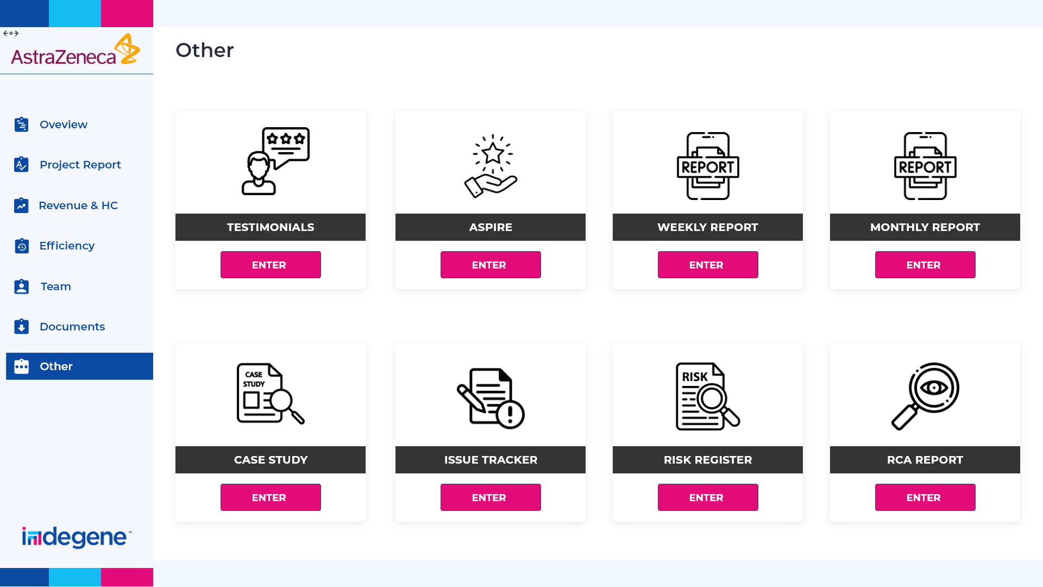

Slide 20
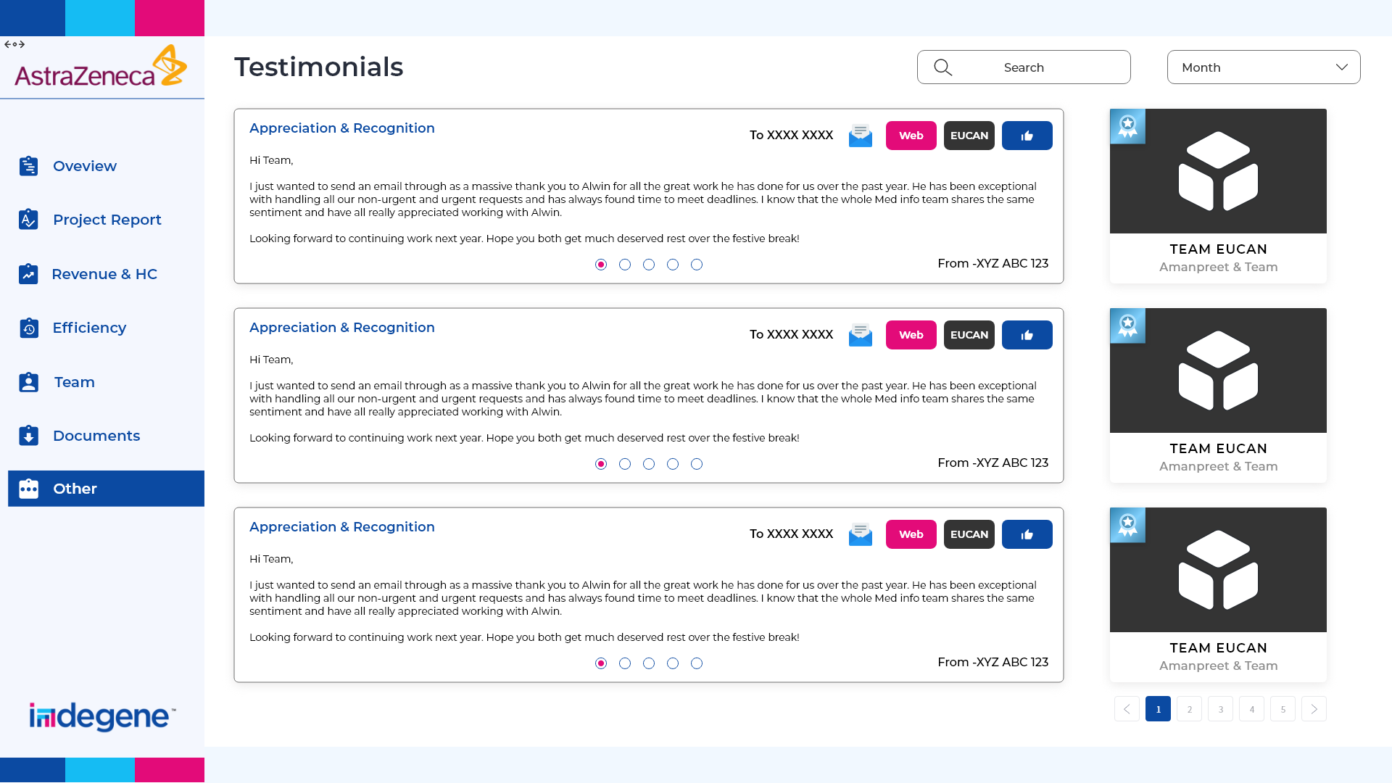

Slide 21
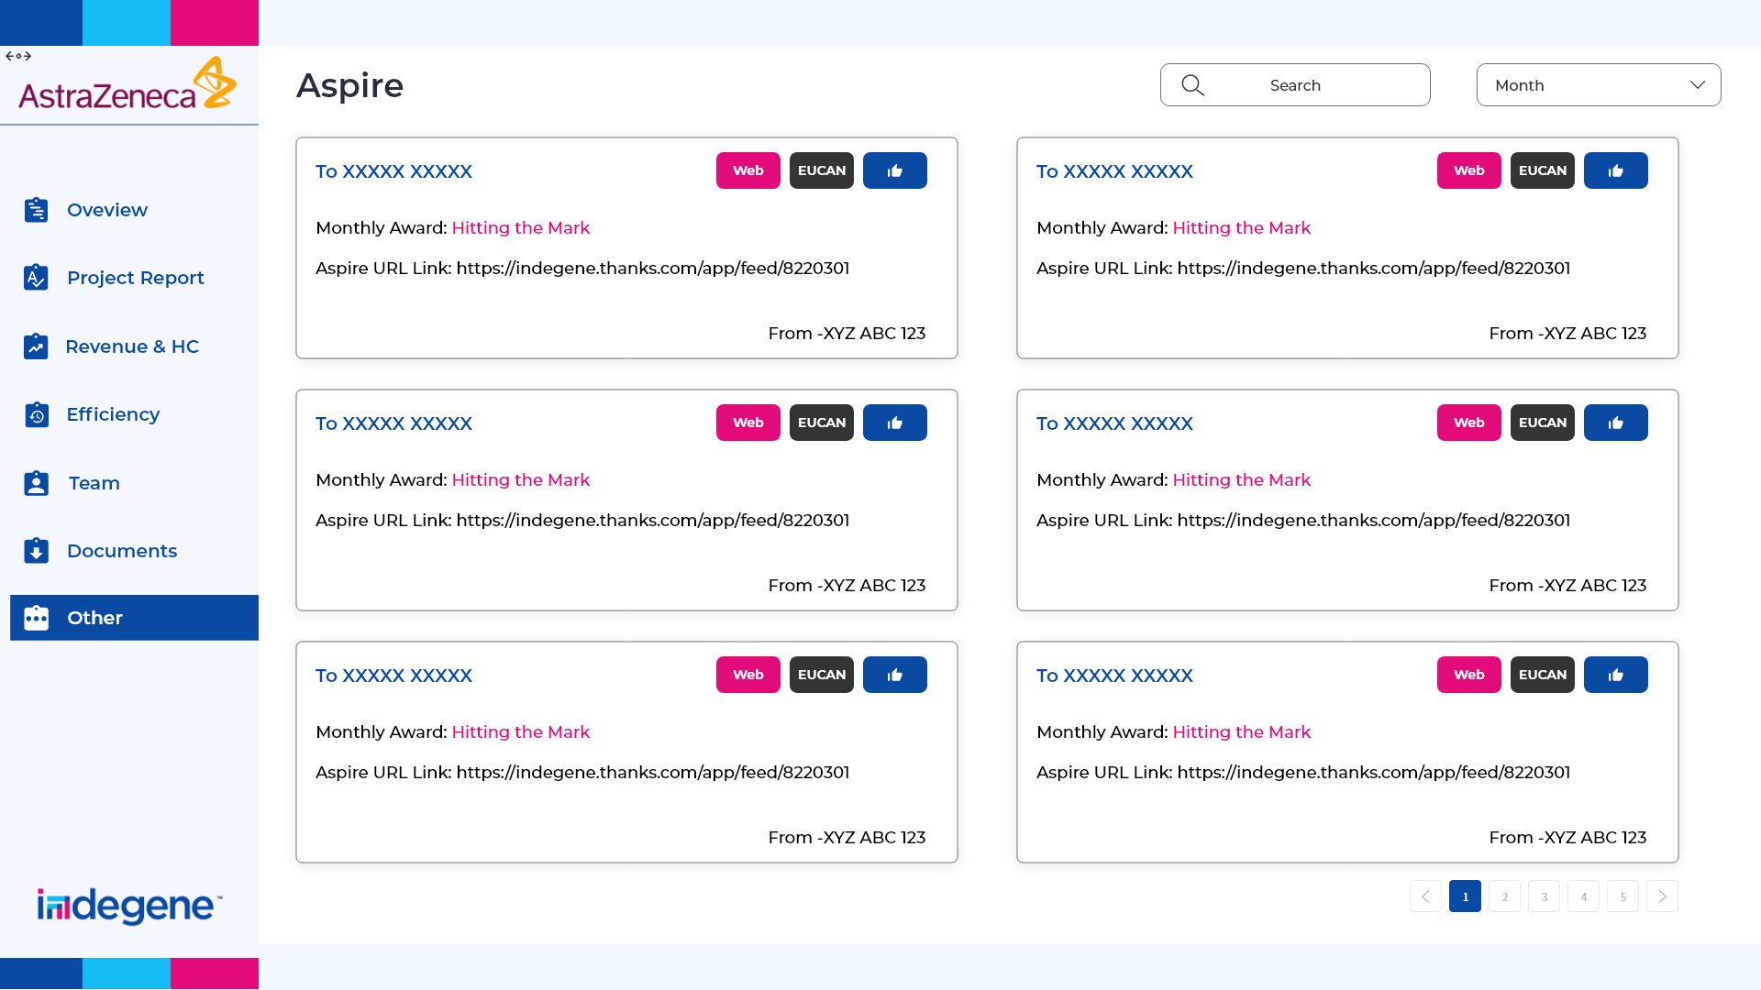

Slide 22
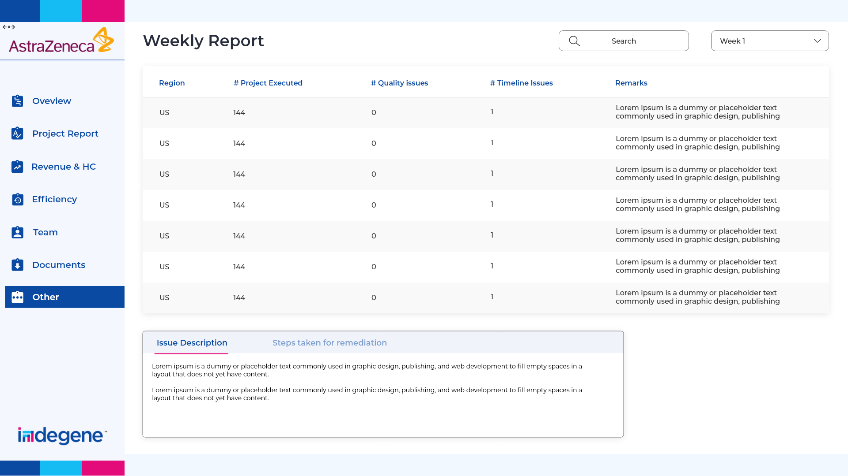

Slide 23
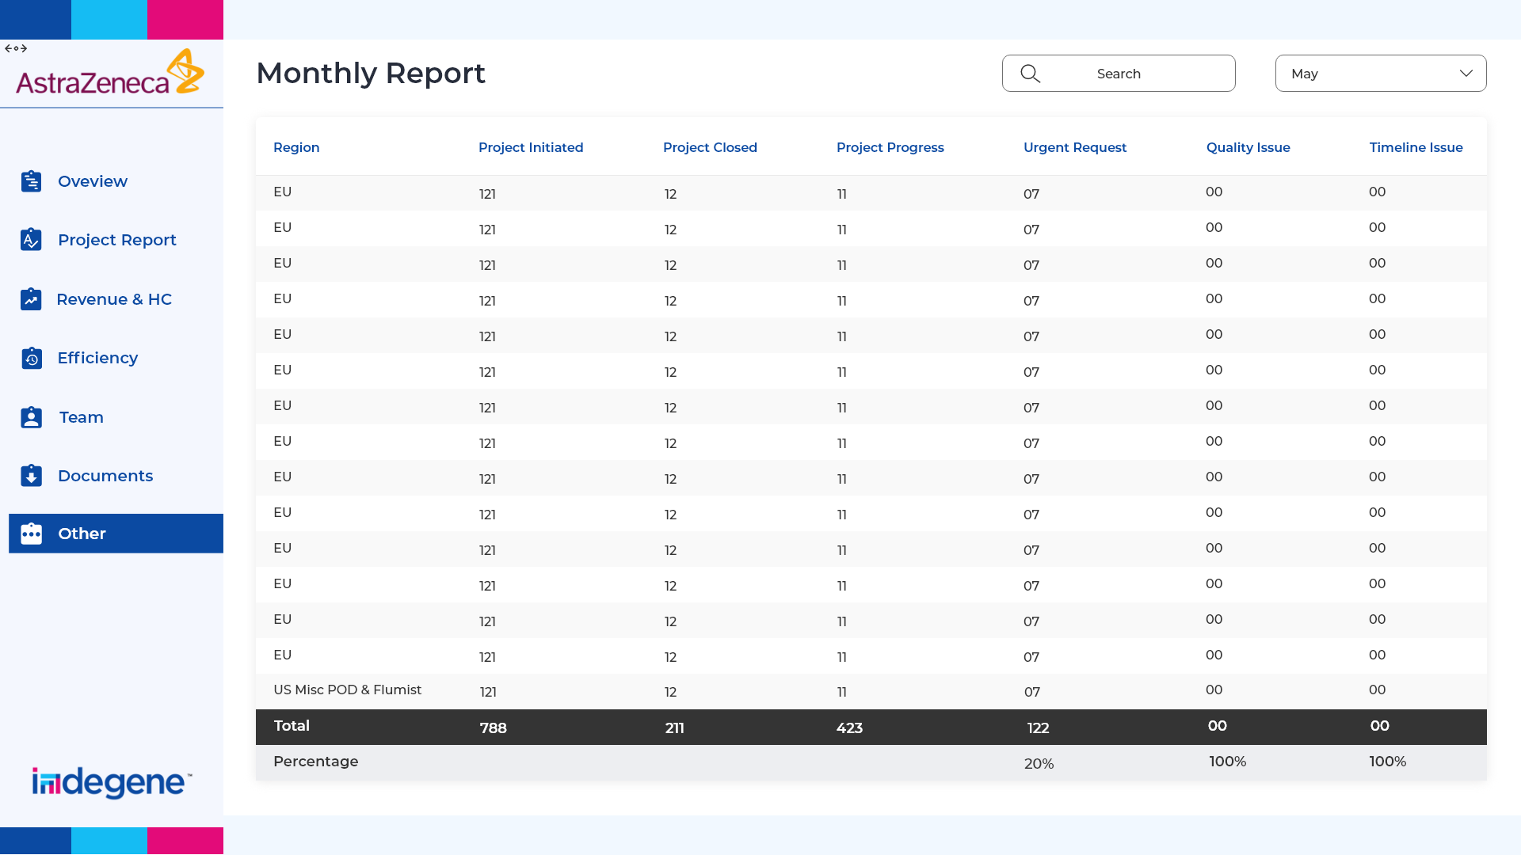

Slide 24
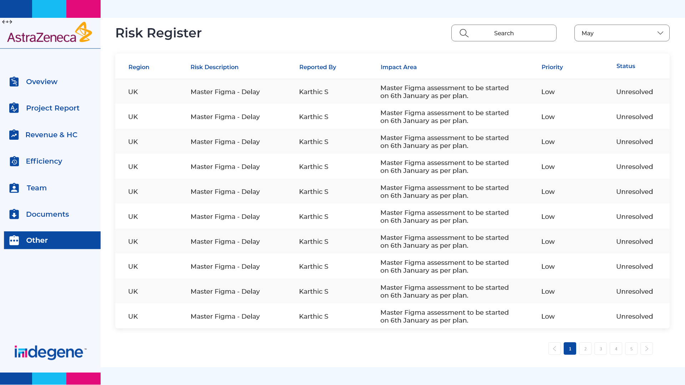

Slide 25
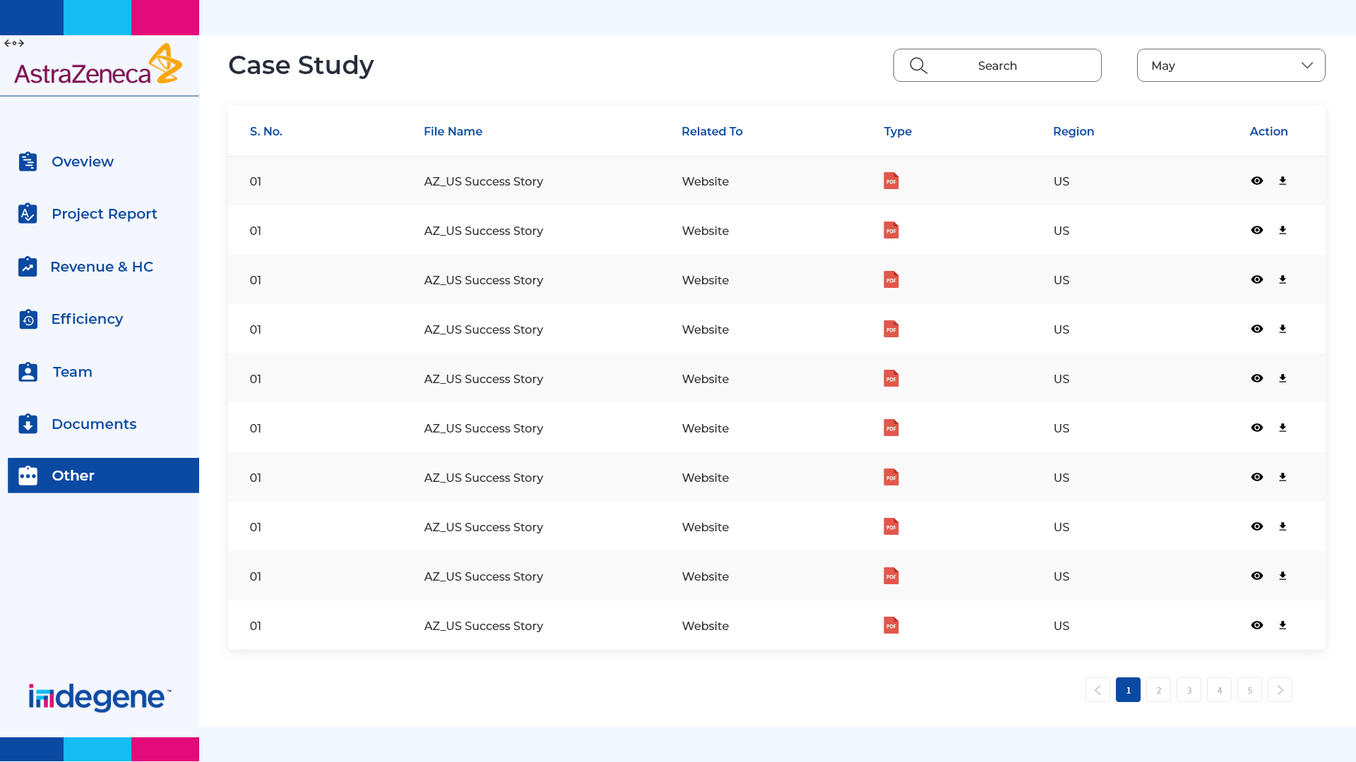

Slide 26
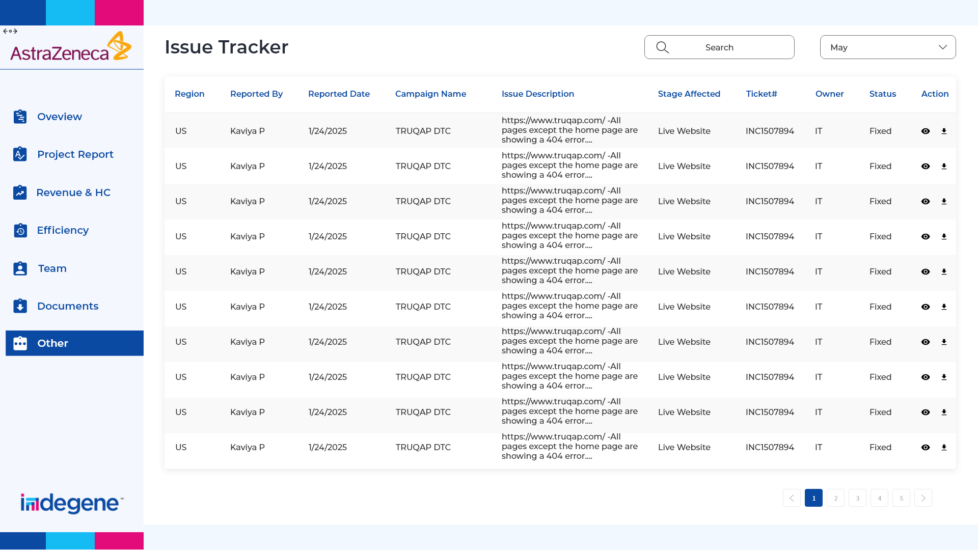

Slide 27
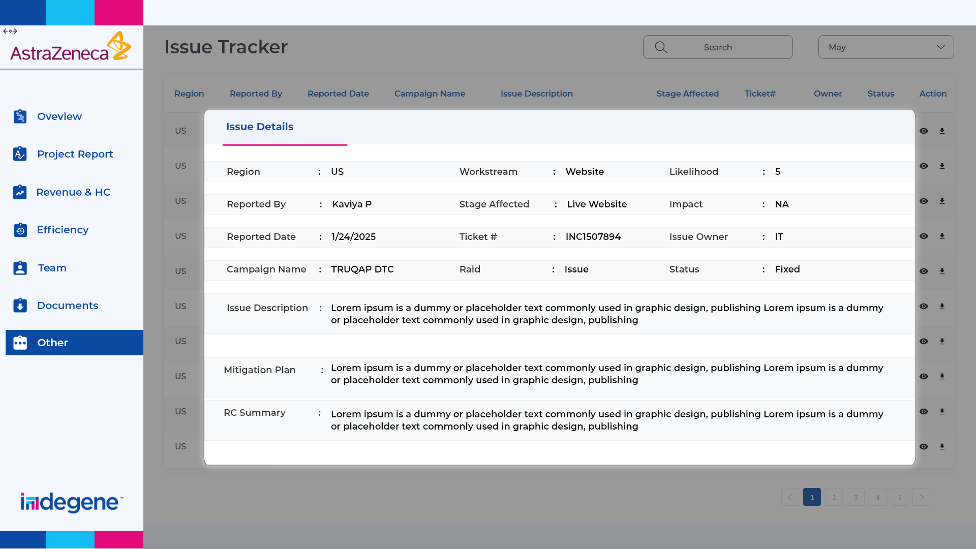

Slide 28
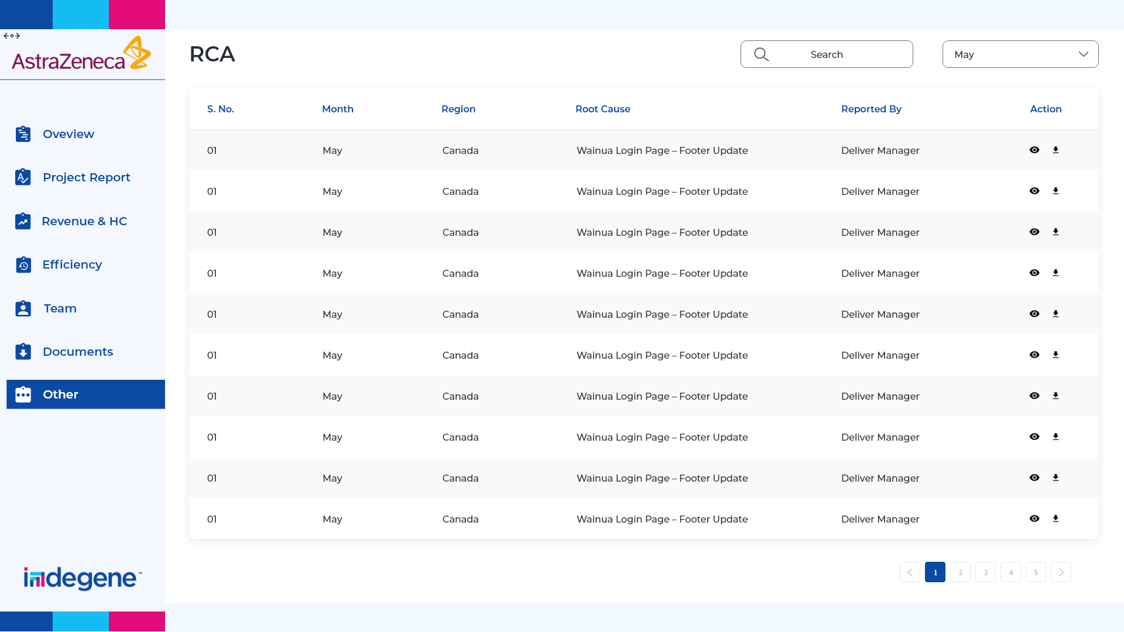

Slide 29
Thank you

